Slide 1
Test-driven development TDD

Slide 2
Testing is the process of evaluating a system or its component(s) with the intent to find whether it satisfies the specified requirements or not.
Testing your code/your system involves looking for any gaps, errors, or missing requirements contrary to the actual requirements.
A test case is a group of conditions under which a tester determines whether a software application is working as per the user’s requirements or not.
Test-Driven Development (TDD) is a methodology in software development that focuses on an iterative development cycle where the emphasis is placed on writing test cases before the actual feature or function is written.

Slide 3
TDD is an iterative approach combining programming, unit test creation, and refactoring.
The TDD approach originates from the Agile manifesto principles and Extreme programming.
As the name suggests, the test process drives software development.
In TDD, developers create small test cases for every feature based on their initial understanding.
The primary intention of this technique is to modify or write new code only if the tests fail. This prevents duplication of test scripts.

Slide 4
Test Driven Development Process/Cycle
TDD approach follows a “Red-Green-Refactor” cycle, which includes the following steps:
Red Phase
The Red Phase is when you write a test that fails, ensuring that your coding works as intended. Failing tests provide valuable information and should be welcomed, as they indicate that the test is working properly.
Green Phase
The second phase is the Green Phase. During this step, you write the code that will make the test defined in the Red Phase pass. You should take care to ensure that the code you write is clean, concise, and effective.
Refactor Phase
The final phase of TDD is the Refactor Phase. During this step, you can modify and refactor the code you have written to be more efficient and easier to read. This is a great way to make sure that your code is efficient and maintainable.

Slide 5
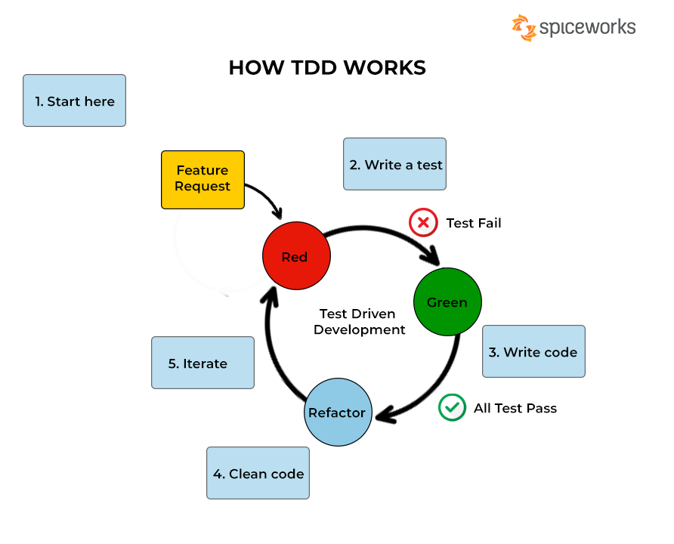

Slide 6
Advantages/Benefits of TDD
Early bug notification. You get to detect bugs early before you even deploy your application. It helps developers better analyze and understand client requirements and request clarity when not adequately defined.
Better Designed, cleaner and more extensible code. Improve code quality. Adding and testing new functionalities become much easier in the latter stages of development.
Good for teamwork. In the absence of any team member, other team members can easily pick up and work on the code. It also aids knowledge sharing, thereby making the team more effective overall. Especially if proper documentation is done.
Good for Developers. It enhances the productivity of the developer and leads to the development of a code base that is flexible and easy to maintain.

Slide 7
Frameworks for Test Driven Development
Based on unique programming languages, there are multiple frameworks support test driven development.
NUnit and csUnit – NUnit and csUnit are frameworks for.NET applications that are comparable in many respects to JUnit.
JUnit– JUnit is a popular open-source framework for Java applications that makes writing and running unit tests straightforward.
PHPUnit– PHPUnit is a PHP unit testing framework that is built to interact with PHPUnit XML logs.
Jasmine– Is a framework for JavaScript applications that makes it easy to develop and execute tests.
RSpec– RSpec is a Ruby application behavior-driven development (BDD) framework that enables developers to design tests that concentrate on the application’s behavior.
PyUnit– PyUnit is a framework for Python applications.
DoceTest – Also another Popular Unit testing framework for Python.
TestNG: Another popular Java testing framework. This framework overcomes the limitations of Junit.

Slide 8
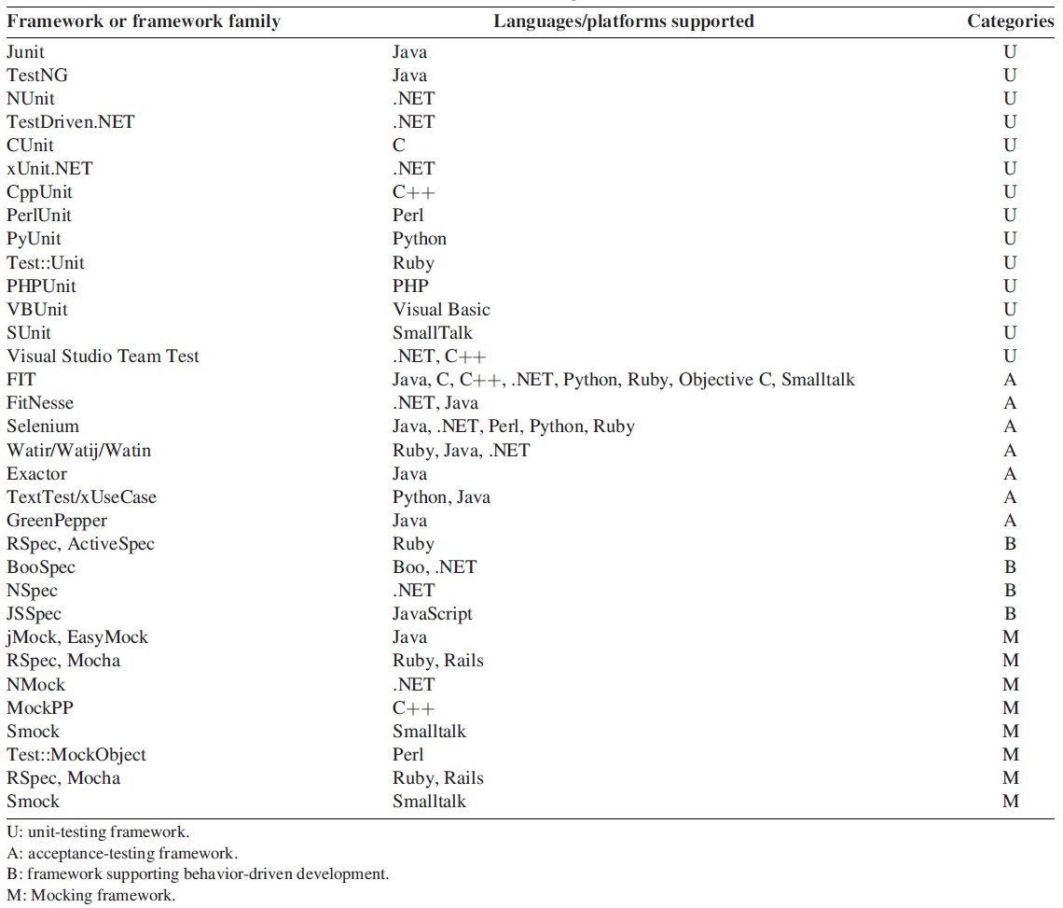

Slide 9
Testing in PYTHON

Slide 10
Python has two main testing frameworks that developers can use:
doctest and unittest.
Doctest
Doctest is an inbuilt test framework that comes bundled with Python by default.
The doctest module searches for code fragments that resemble interactive Python sessions and runs those sessions to confirm they operate as shown.
The doctest module looks for sequences of prompts in a docstring, re-executes the extracted command, and compares the output with the command’s input given in the docstring’s test example.

Slide 11
Unittest
Unittest test case runners allow more options when running tests, like reporting test statistics such as tests that passed and failed.
Unittest has several rich, in-built features that are unavailable in doctest, including generators and group fixture managers like setUp and tearDown.
Since unittest follows the object-oriented method, it’s more suitable for testing class-based methods in a non-production environment. Continuous delivery tools such as Jenkins or Travis CI work better for production environments.

Slide 12
The main methods that we make use of in unit testing for Python are:
assert: base assert allowing you to write your own assertions
assertEqual(a, b): check a and b are equal
assertNotEqual(a, b): check a and b are not equal
assertIn(a, b): check that a is in the item b
assertNotIn(a, b): check that a is not in the item b
assertFalse(a): check that the value of a is False
assertTrue(a): check that the value of a is True
assertIsInstance(a, TYPE): check that a is of type TYPE
assertRaises(ERROR, a, args): check that when a is called with args, it raises ERROR

